Slide 2
School-to-Work Transition Guide for Illinois
ICTW Symposium - April 25, 2024
Jim Mayer, M.S., CRC/retired
ICTW Training Specialist
Notes:
Give some personal background.

Slide 3
Why an Interagency Transition Study Group?
Goals and Mission of the ICTW:
GOALS:
To be a statewide resource on evidence-based practices for special educators, vocational rehabilitation professionals, related services personnel, and school administrators.
To build Illinois’s capacity for interagency collaboration to support the transition from school to work of students with significant disabilities.
MISSION:
The Illinois Center for Transition and Work (ICTW) is a statewide resource that utilizes research to develop products, deliver professional development, and provide technical assistance to enhance the transition from school to work for students with disabilities who have extensive support needs.
Notes:
Responding in particular to goal #2, an Interagency Transition Study Group was formed in the Spring of 2023, to examine needs and discuss solutions.

Slide 4
Mission of the Interagency Transition Study Group
Will be comprised of special educators, vocational rehabilitation counselors, and administrators from across Illinois.
Will examine the specific roles, responsibilities, resources, legislation, and funding that currently guide the school-to-work transition process in Illinois.
Will examine federal & neighboring state resources.
Will develop an Illinois School-to-Work Transition Guide that can be used by key stakeholders throughout the state.
Notes:
Needs analysis resulted in a mission to create a comprehensive statewide “School-to-Work Transition Guide” resource.

Slide 5
Why a School to Work Transition Guide?
The Transition Study Group identified the need to clarify the following aspects of school-to-work (STW) transition for all parties involved, with info specific to Illinois:
Key individuals, and their roles and responsibilities
Important steps and stages in the STW transition process
Key terms and definitions for the STW transition process
Legal aspects of the STW transition process
Helpful guidelines and resources for the STW transition process
Notes:
Needs identified by Interagency Study Group.

Slide 6
Development of the STW Transition Guide
National guidance: e.g., OSERS Transition Guide, NTACT
Ideas from other states: e.g., WI, IN, PA, VA
Federal and State Laws re Transition
IL Policies/Regulations: e.g., ISBE, IDHS/DRS
Important Components/Content for Illinois
Notes:
Sources for Study Group research and early planning.

Slide 7
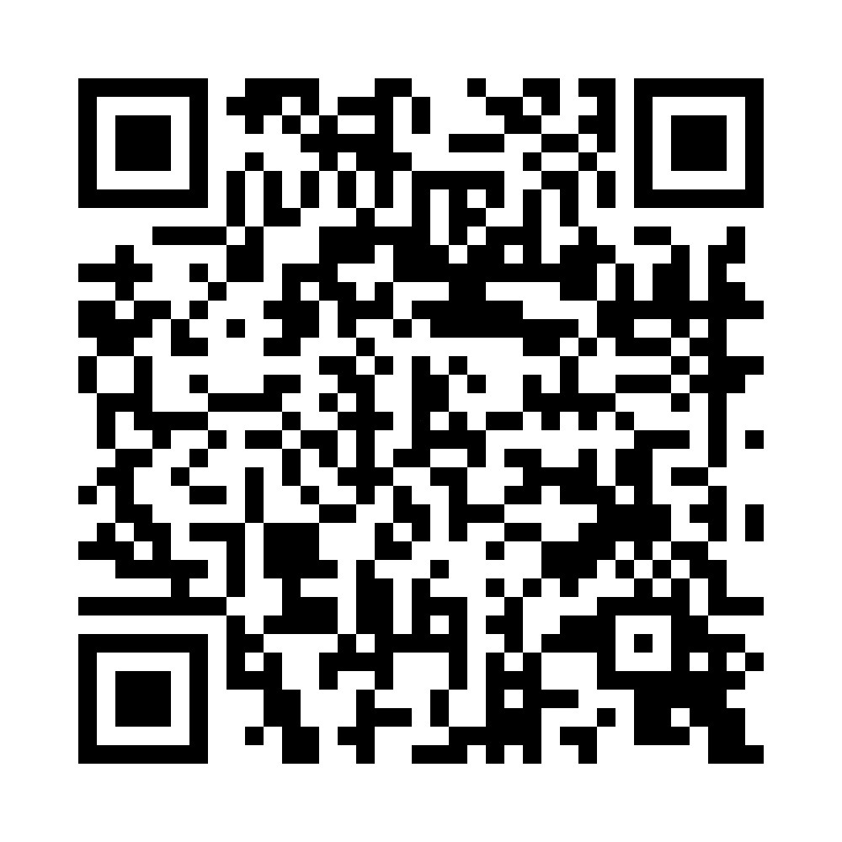
Access to the STW Transition Guide
Direct Link: https://ictw.illinois.edu/resources/school-to-work-transition-guide
Notes:
Explanation of multiple ways people can access the Guide – 39 page document – prints double-sided onto 20 sheets of paper.

Slide 8
Components of IL School-to-Work Transition Guide
1. Words and Terms to Know
2. Overview of the Transition Process - a Flow Diagram
3. Features of the Transition IEP
4. Transition IEP Team Members - Roles & Responsibilities
5. Timeline for Transition Planning
6. Transition and the Law
7. The PUNS System (for Students with Developmental Disabilities)
8. The Summary of Performance
9. Key Resources & Sample Transition Surveys
(Note: Interactive Table of Contents – built-in “buttons” to each section/component)
Notes:
Table of Contents – provides a quick view of the nine Guide components/sections.

Slide 9
Section 1: Words and Terms to Know
Goals:
Spell out key terms and acronyms
Strive to define terms in understandable language
Provide a convenient, alphabetized list of terms at the front of the manual, so it is easy to access at any time
Result: 41 key terms defined and "demystified"
Notes:
Terms and acronyms clarified before launching into content areas – and easy to find as an alphabetical reference.

Slide 10
Section 2: Overview of the Transition Process - a Flow Diagram
Notes:
Annual Process, beginning at age 14.5
Guided by ongoing assessments, and student experiences
Notes:
Overview of IEP requirements 1 thru 5. Note the numerical, logical flow of these requirements. And, note the IL requirement that transition planning begins the year that the student turns 14.5 years of age. Further note that the process is to be guided by ongoing assessment.

Slide 11
Section 3: Features of the Transition IEP
Defines and provides examples of key features of transition IEP, including:
Age-appropriate transition assessments, measurable postsecondary outcomes, courses of study, coordinated set of transition services/activities, annual IEP goals for transition, & linkages to after-graduation supports and services
Highlights information on Illinois ABLE accounts, PUNS, and opportunities for CTE - schools are now required to disseminate this information at annual IEP meetings
Notes:
Note that this Section further fleshes out details of the 5-step process, plus provides additional info on important IEP terms, and needs particular to transition planning in Illinois, e.g., PUNS, ABLE & CTE info.

Slide 12
Section 4: Transition IEP Team Members - Roles & Responsibilities
Essentially, "job descriptions" for the following key team members:
• The Student*
• Parent(s)/Guardian(s)
• School Staff: Special Education Teacher/Case Manager, General Education Teacher(s), School Administrator(s), Guidance Counselor, Vocational/STEP Coordinator, and Related Services Staff (e.g., School Social Worker, School Psychologist, Speech Therapist, PT/OT services, etc.)
• Vocational Rehabilitation Counselor (from IDHS/DRS - Div. of Rehabilitation Services)
• Community service provider(s)
Includes basic definitions and clarification re various services.
Notes:
Note that, for the student and parent, the descriptions include both “how to prepare for your IEP meeting” and “how to participate in your IEP meeting.” For School staff, there is both a general list of team responsibilities (which primarily include Case Manager responsibilities) and more specific, brief descriptions of various specialists who may serve on the school team. Similarly, for IDHS/DRS there is a detailed description of the role of the DRS Counselor, followed by descriptions of various services provided by IDHS/DRS. Finally, the community service provider description includes some general roles of these providers, followed by specific paragraphs about five of the most common types of community providers.

Slide 13
Section 5: Timeline for Transition Planning
Includes key tasks for each transition grade level
Indicates ongoing tasks
Highlights tasks unique to each given grade level
Includes details for given student scenarios/goals (e.g., info for college-bound students; info re PUNS list registration.)
Notes:
Key tasks listed yearly, beginning in 8th grade (or the year in which the student turns 14.5 years.) After 8th and 9th grade, some tasks are listed as ongoing (or “continuing”) while other tasks are listed as “new to this grade level.” There is a final description of tasks particular to students who remain in school for age 18-22 transition services.

Slide 14
Section 6: Transition and the Law
Highlights key legislation that impacts transition-age students with disabilities (e.g., IDEA, The Rehabilitation Act of 1973, WIOA, Americans with Disabilities Act, etc.)
Describes the difference between entitlement systems (special education under IDEA) vs. eligibility systems (adult services)
Outlines important terms related to Social Security
Describes options for families related to Educational Rights, Transfer/Delegation of Rights, and Age of Majority (e.g., Guardianship, POA, Supported Decision Making)
Notes:
This section separately highlights first Federal laws & policies, then secondly State laws & policies. The approach is to give short summaries of key laws and policies, in understandable language.

Slide 15
Section 7: The PUNS System (for Students with Developmental Disabilities)
Explains what PUNS is and who it is for
Describes how to enroll in PUNS and how to regularly check your status on the PUNS "list"
Answers FAQs that families or service providers may have about PUNS, such as
What types of services can this funding cover?
What is the difference between the two categories (planning and seeking services)? How do I move from one to another?
How do I know if/when I am pulled for funding?
Notes:
This section provides key information for Special Education Case Managers and parents of students with developmental disabilities.

Slide 16
Section 8: The Summary of Performance
Describes what a Summary of Performance (SOP) is and why it is needed
Breaks down the key components of the SOP
Shares helpful tips for educators to ensure the SOP is meaningful and beneficial for the student, such as
Actively involving the student in developing the SOP
Linking the SOP with the IEP process
Thinking about a student's future environment (e.g., adult services) when developing the SOP
Provides a link to a sample SOP template from ISBE
Notes:
In addition to explaining the key components of the SOP, this section highlights how to get the student involved in planning for their exit from school and entrance into adult life. Emphasis is placed on making this a useful exercise and a useful document for the student’s transition to adult life – a potential tool to help the student communicate their needs to adult service providers.

Slide 17
Section 9: Key Resources & Sample Transition Surveys Resources Alpha-listed, by category, with embedded links
Categories:
ADVOCACY & FAMILY SUPPORT
ASSISTIVE TECHNOLOGY & ACCOMMODATIONS
BENEFITS
DEVELOPMENTAL DISABILITY SERVICES
EDUCATION/TRAINING
EMPLOYMENT
HOUSING & INDEPENDENT LIVING
GUARDIANSHIP & LEGAL ASSISTANCE
MENTAL HEALTH
RECREATION & LEISURE
TRANSPORTATION
Notes:
First, Section 9a “Key Resources” – this section emphasizes statewide and national resources - lists resources alphabetically within 11 categories.

Slide 18
Section 9: (Continued) Sample Transition Surveys
Includes two sample transition surveys (one student, one parent/guardian) to be completed at least twice while the student is in school
Covers domains of employment, postsecondary education/training, independent living, and recreation/leisure.
Information gleaned from these surveys can contribute to a meaningful and individualized transition plan
Surveys can be modified from their current form for students with diverse learning and communication needs
Notes:
Second, Section 9b “Sample Transition Surveys” – the student and parent transition surveys are designed to gather key information for both the IEP (school planning document) and the IPE (IDHS/DRS planning document).

Slide 19
Distribution and Promotion of Guide
In Process – Please help get the word out:
Email blasts from ICTW and other orgs
Social media announcements
Conference presentations (e.g., ITC, IAASE, ICEC, TASH, etc.)
Links to the Guide on commonly used websites (statewide & local – consider posting link via TPC, ROE, Coop. & school district websites)
Outreach to parent and advocacy groups (e.g., newsletters, announcements, etc.)
Other ideas? Please let us know!
Notes:
Encourage use & distribution. Let the ICTW know how we can help you get the word out about this important resource in your part of the State.

