Slide 1

High School Youth Apprenticeship Program
Paula Bradford – Madison County ROE
Tony Fuhrmann, Madison County Employment and Training
Darlene Ladd, Madison County Employment and Training
Kayla Boesing, Madison County Employment and Training

Slide 2



WHAT IS AN APPRENTICESHIP?
Employer-driven model that can be carved and flexible to meet the employers needs to train and develop employees
Earn while you learn, structured education and training, increasing work skills while earning a paycheck
Combines on-the-job training (OJT) and job-related instruction that leads to the attainment of industry-recognized credential
Notes:
Tony

Slide 3
Department of Labor Registered Apprenticeship Model
Foundations
1
Employer Involvement
2
Industry Credentials
01
Rewards and Skills Gains
Related-Instruction
3
4
02
5
Structured On-the-Job Training
03
Registered Apprenticeships are registered with the U.S. Department of Labor and meet the 5 requirements
3 Types of Apprenticeships: Time-Based, Competency, or Hybrid
04
05
Notes:
Tony

Slide 4

How it all began….
By accidental planning:
  Collinsville High School was looking for opportunities for students in the Special Education STEP Program
  City of Collinsville needed employees for several positions due to a worker shortage as a result of COVID shut –downs
  After several meetings between the High School Staff, City Staff and Madison County Employment and Training the positions were identified and discussions with DOL began

Slide 5
The apprenticeship began with the Gateway Convention Center & Parks and Recreation Department
Apprentice Positions:
  Convention Center Housekeeping
  Event Set-Up/Removal
  Grounds Keeping

Slide 6
The Start Up:
Positions were standard openings, modified or job carved to meet the needs of the employer, apprentices work availability and DOL Standards
Apprentices work schedule was from 1pm to 4pm, Monday – Friday
Transportation was provided by the City to the worksite.
6 STEP Students were hired as the first apprentices
          Disabilities Included: Cognitive Impairments, Autism, and Learning Disabilities
          Ages 18-21
          Senior in High School

Slide 7

Related Training Instruction:
Students are participating in the STEP program. They have vocational based classes to help prepare them for working and transitioning to adult living, beyond high school.
Curriculums are provided by the High School. If not STEP, then a vocational training curriculum.
Lesson Plans can be modified or used to address work related behavior or problems. The entire class is addressed to provide broader learning for all students.

Slide 8
PROBLEMS:
First Year back from remote learning due to COVID- resulted in an increase of behaviors/outbursts/not work ready
Students were not matched to the positions, they were not interested in the jobs. They broke personnel and safety policies
Job Coaching not available
Students, School Staff, Parents, and Front-Line Staff did not understand the difference between a co-op job/internship and apprenticeship
Front line staff were not prepared to job coach, mentor and train apprentices

Slide 9
THE FIRST APPRENTICESHIP
2 were terminated due to Employee Infractions
2 did not meet the competencies
1 unable to complete due to disciplinary action at School
1 Apprentice successfully completed and earned his DOL Apprenticeship Certificate in Grounds Keeping, and continued working in the position

Slide 10
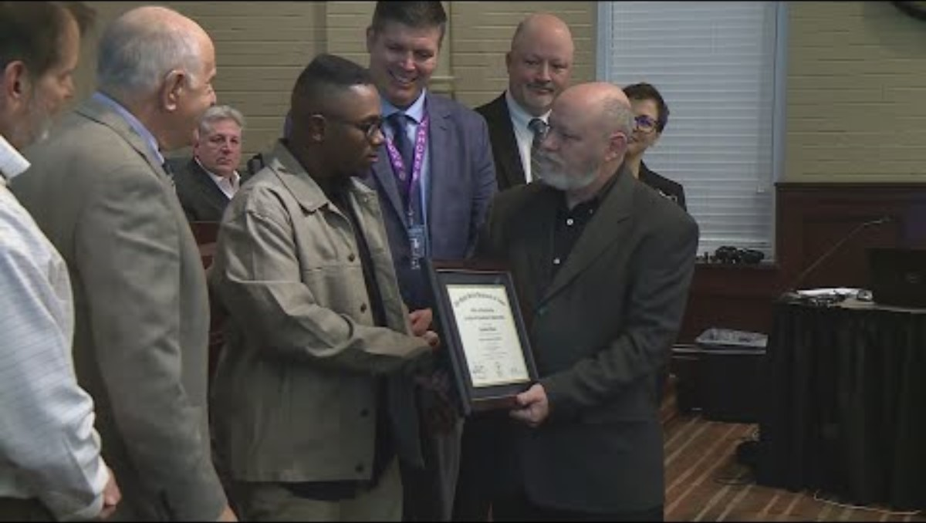

Slide 11
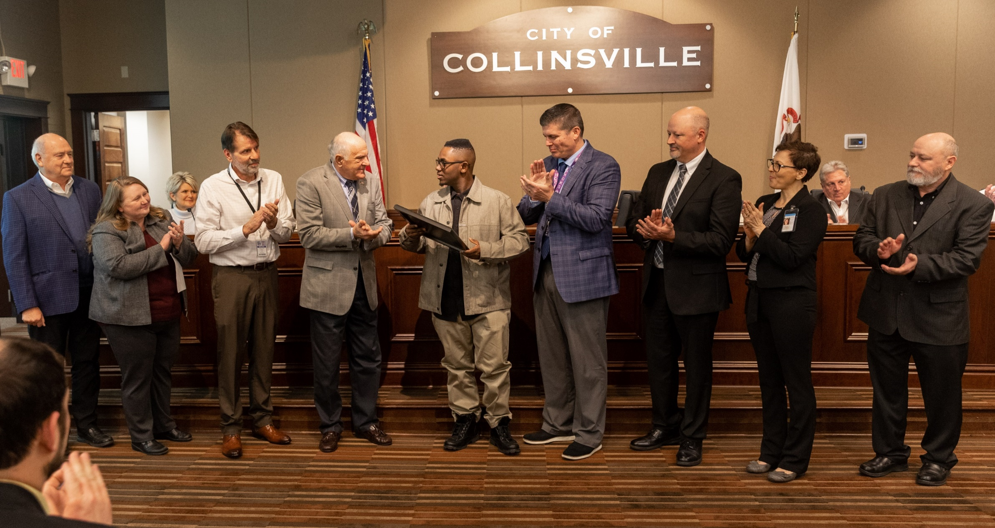

Slide 12

The SOLUTIONS:
Honest Round Table Meetings
Regular communication from the supervisors
Curriculum developed for staff to help with basics of communication, understanding learning styles, de-escalation- Job Coaching for Success
Student Worker Handbook
Meetings to define work expectations with Worker, Home Supports, Employer, School and Madison County Staff

Slide 13
WHO ARE THE PARTNERS?
Employer
Student-Apprentice
Supports/Family/Guardian
School District STEP Program/ Regional Office of Education & Division of Rehabilitation
Madison County Employment and Training

Slide 14

Model Improvements/What we learned:
There are 2 customers: The business and the student
Apprenticeship position: A real job, needed by the employer with realistic expectation of work. Job Carving is a must, what can be accomplished in 3-4 hours per work shift
Apprentice Application – to be completed by student returned to MCETD
Apprentice Screening- interviewing to determine if they are work ready.- enhanced job matching.
Supports provided by MCETD to the Employer and Apprentice to help bridge gaps, aid in learning, and enhance communication

Slide 15

Partner Responsibilities: Madison County Employment and Training (Local Workforce Area – WIOA)
1. Work with the employer
2. Reach out to area schools, find the apprentice applicants
3. Review the applicants, select the best candidates to meet the employer needs.
4. Facilitate the Employer Interview
5. Develop the Contract with the Employer for the WIOA Subsidies
6. Enroll the Apprentice in WIOA Registered Apprenticeship
7.Career Specialist provides supports for 2 years (1 year during apprenticeship and 1 year follow up)

Slide 16
High School STEP/ ROE and DRS
The STEP Program is funded by Division of Rehabilitation, and coordinates with the Regional Office of Education for enhanced vocational services.
STEP Provides:
  Job exploration
  Work based learning experiences
  Post –Secondary education counseling
  Work –place readiness training
  Introduction to self-advocacy
  RTI- Related Training Instruction
  Supports for students and employers
  Aid student in completing WIOA paperwork

Slide 17
Apprentice Responsibilities
Attend school as scheduled for RTI completion
Adhere to employer policies and rules
Work scheduled shifts/days to meet required hours
Communicate with Employer, STEP Coordinator/Teaching Staff MCETD Case Manager

Slide 18
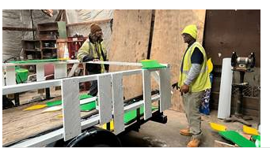
EMPLOYER
Employer’s Role:
  Providing Job Descriptions
  Developing Work Competencies
  Host tours/ work demonstrations
  Interview potential apprentices
  Develop Mentor
  Staff for supervision/training/natural supports
  Submit Invoicing/Progress Reports for OJT reimbursement
  Communicate with MCETD staff for supports and problem solving

Slide 19

How is our Model Different
Job Carving/ flexibility
Meeting the apprentices, learning their employment goals, prior to the employer interview
Enrolling the Student into WIOA Services
Providing On the Job Training funding to the employer, during the apprenticeship
Providing support services to the employer and the apprentice
Team approach, regular check ins, communication, problems solving.
Resources: referrals to WIPA for benefits, providing families Red Book

Slide 20
Resources Added:
Student Advocacy- Encouraging Students to tell employer how they learn best.
Training for Employers such as Job Coaching for Success, Seizure Care.
Employer Contact Sheet- 1 Page that explains who to contact on the team, when and why

Slide 21
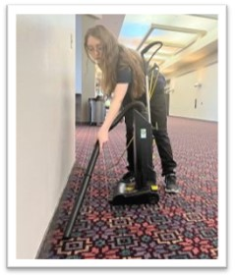

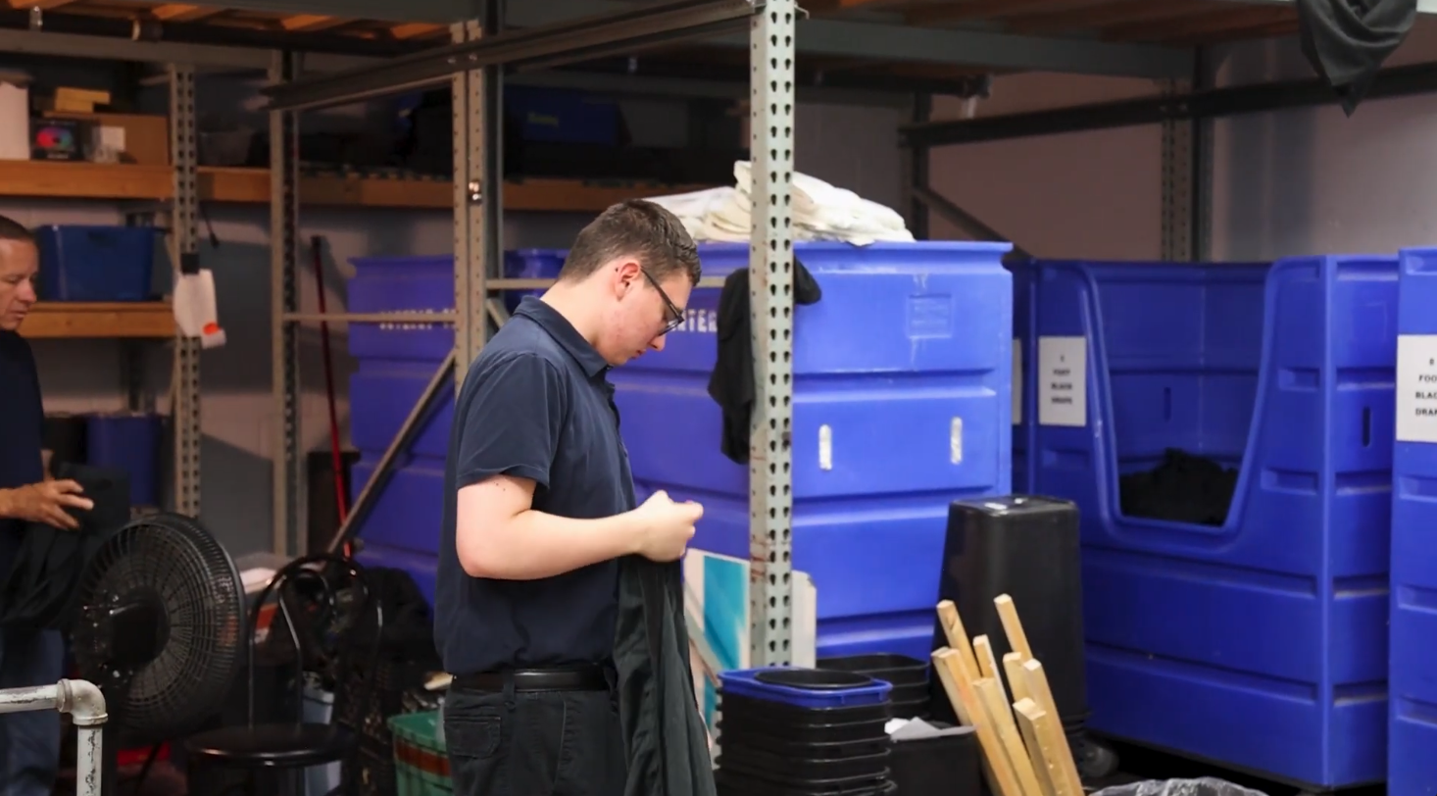

Start up and Expansion
City of Collinsville- Collinsville High School
  4 Registered Apprenticeships
  Housekeeping
  Event Set Up/ Removal
  Groundskeeping/ Landscaping
  Streets Dept
  7 completers
  1current Apprentice

Slide 22
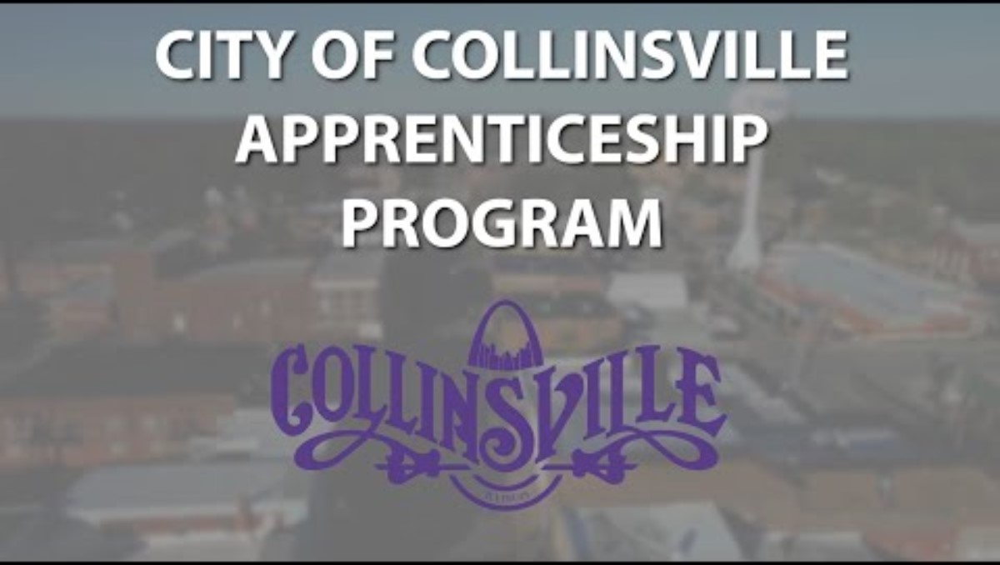

Slide 23
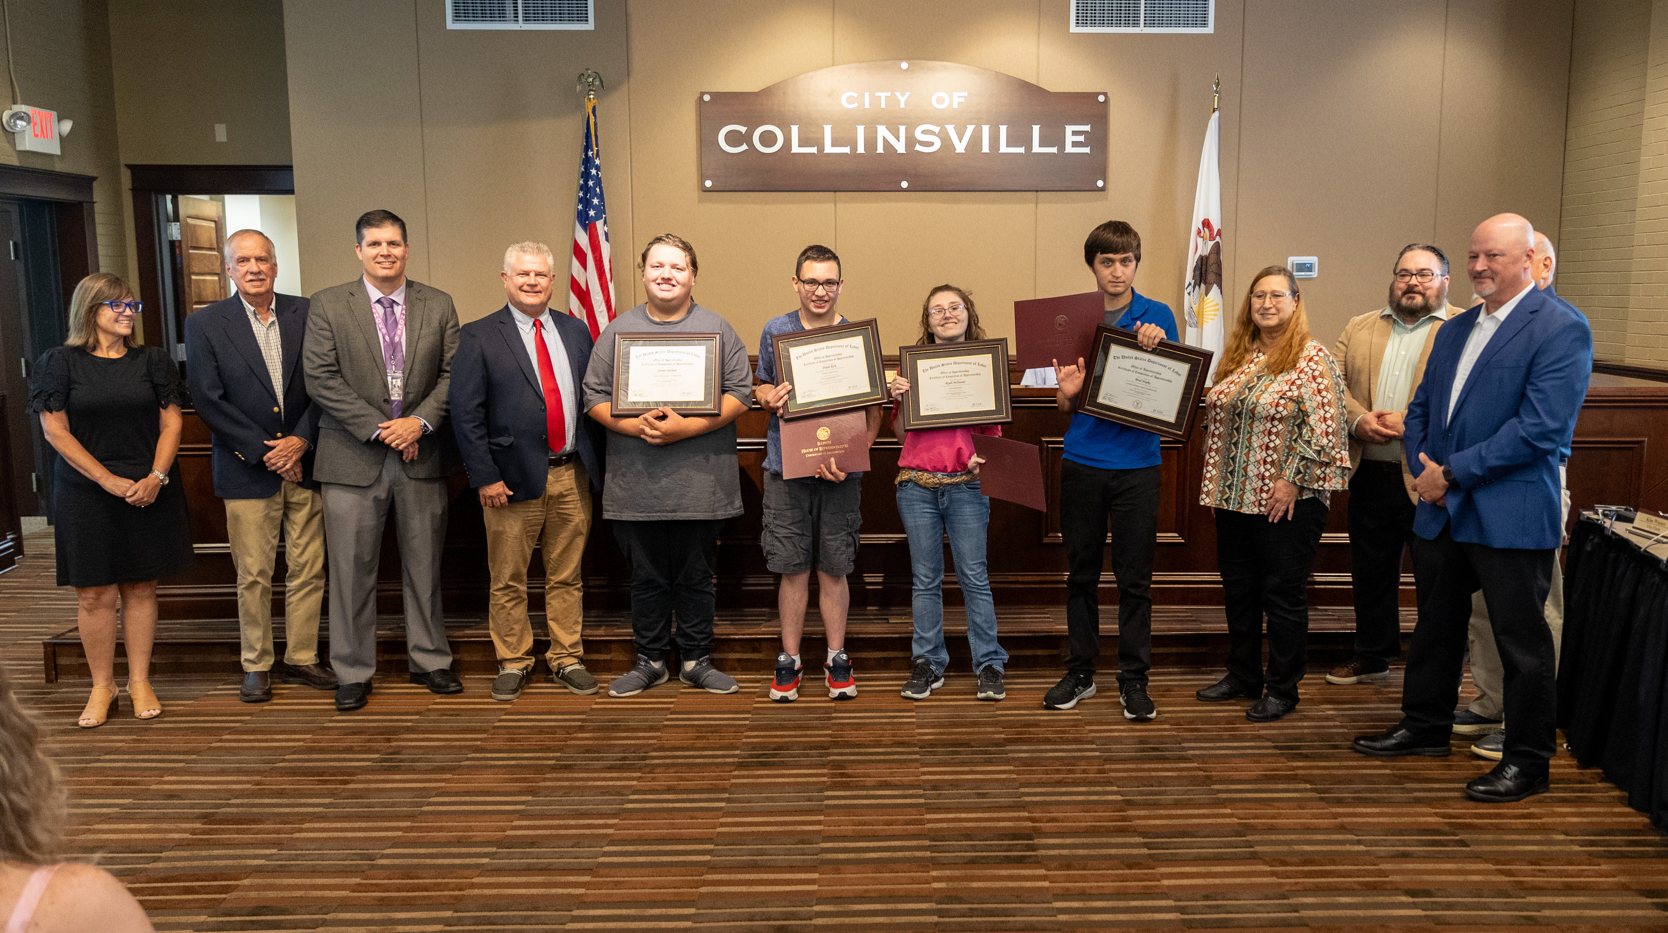

Slide 24
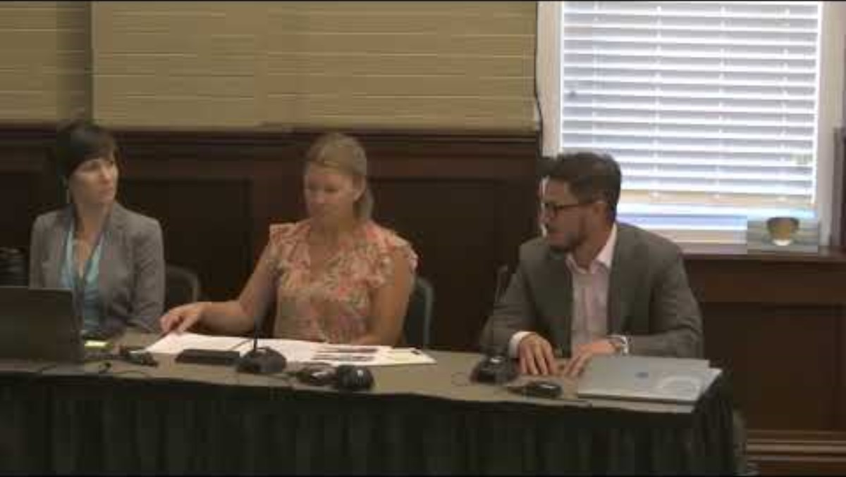

Slide 25

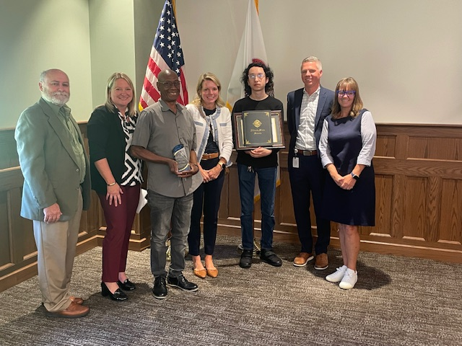

Second Registered DOL Apprenticeship
Agency for Community Transit (ACT)- Edwardsville High School
  1 Registered Apprenticeship
  Bus Sanitizer
  1 completer
  1 Current Apprentice

Slide 26
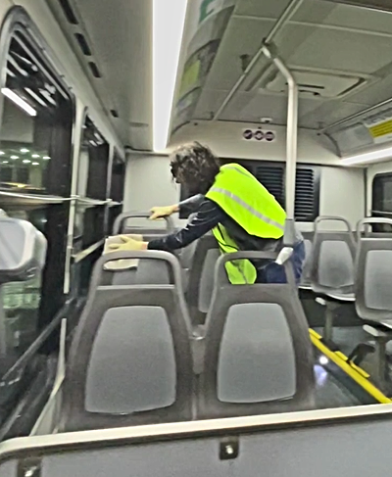
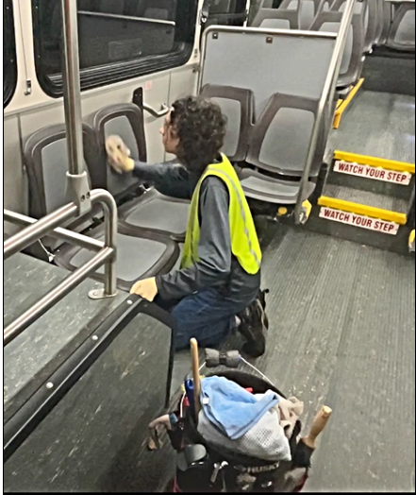

Slide 27


The First Private Industry Registered Apprenticeship
West Star Aviation- Bethalto Civic Memorial High School
  1 Registered Apprenticeship
  Housekeeping
  1 completer

Slide 28




Expansion into Private Industry
Icon Mechanical- Granite City High School
1 Registered Apprenticeship
Safety Administrative Assistant
1 completer
Weber Chevrolet- Granite City High School
1 Registered Apprenticeship
Warehouse Associate/ Parts Runner
Scroggins Law Office- Granite City High School
1 Registered Apprenticeship
Legal receptionist

Slide 29


Continued Expansion into Private Industry:
Supplied Energy-
Bond County Community 2 High School High School
  1 Registered Apprenticeship
  Warehouse Associate
  1 current apprentice

Slide 30
