Slide 2
It Takes a Village:
Reactivating a Transition Planning Committee (TPC) in a Rural Community
Nicole Birri, Training Specialist- Illinois Center for Transition and Work
Abby Clark, Special Education Coordinator- Kaskaskia Special Education District 801

Slide 3
Objectives
By the end of this session attendees will:
Acquire knowledge related to the Importance of Transition Planning Committees
Learn how to take the initial steps in forming a committee, including the selection of participants/stakeholders
Discuss various goals and projects that a newly formed TPC can undertake to fill needs within their service region

Slide 4
About Us
About You
Is there an active TPC in your community?
Are you a member?
Dr. Nicole Birri
Training Specialist ICTW
Abby Clark
Special Education Coordinator KSED

Slide 5
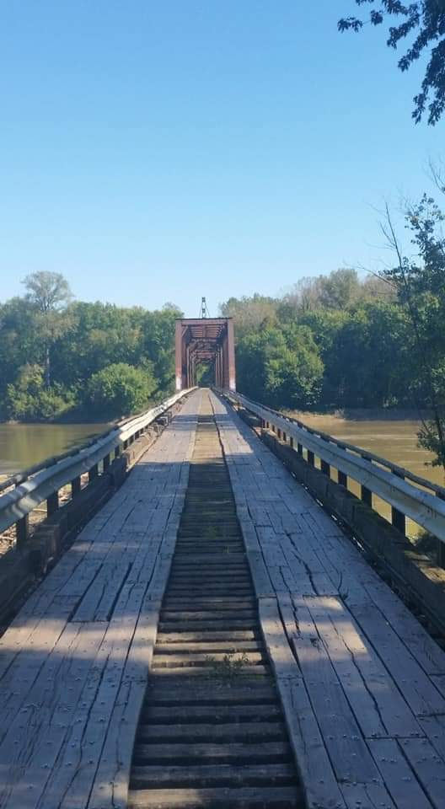
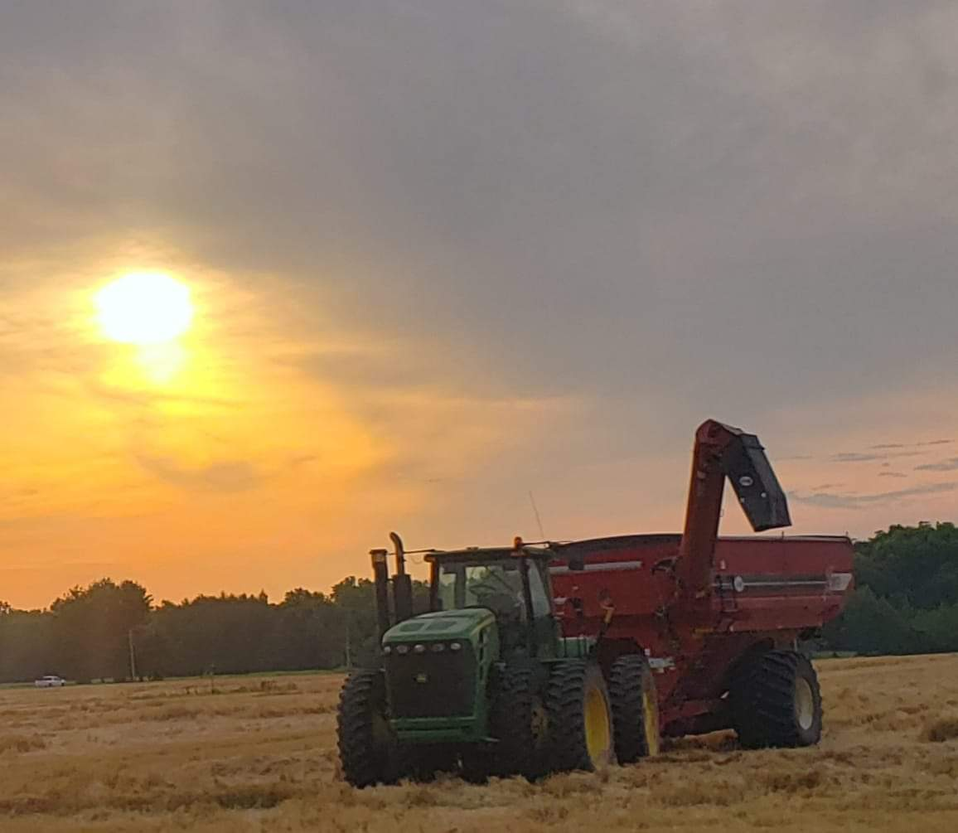
KSED 801 Demographics
Counties Served: 3 total
Clinton
Marion
Washington
Schools Served: 56 total
41 public schools
12 parochial
3 alternative placements
Rural Area: 1638.13 miles
Students with IEPs: 3000+
Students with 504 Plans: 370+

Slide 6
KSED Concerns Related to Transition
Poor outcomes for students with disabilities across all three counties based on Indicator 14 data
Minimal work based learning opportunities
Limited community experiences and engagement
Minimal to no collaboration between school based representatives and community agencies
No formal assessments or standardized curriculums being used with a focus on postsecondary outcomes

Slide 7
Our Partnership
Initially learned about ICTW at Illinois Statewide Transition Conference in November 2022
Approached Nicole after her session at the Special Education Directors Conference in June 2023
Targeted Technical Assistance request submitted Summer 2023
TTA plan created in September 2023

Slide 8
Importance of Transition Planning Committees

Slide 9
Transition Planning
Transition planning is used to describe the very intentional, organized and coordinated process of guiding young people with disabilities with education, experiences, supports and services to help them have successful and meaningful lives beyond high school.
It is planning that begins with the end in mind.
Transition Planning - NTACT:C. (2024, April 5). NTACT:C. https://transitionta.org/topics/secondary-education/transition-planning/

Slide 10
Federal Requirements for Interagency Collaboration
Interagency collaboration has been mandated by federal legislation requiring schools, community organizations, and governmental agencies to work together.
Individuals with Disabilities Education Act (IDEA 1990, 2004)
Every Student Succeeds Act (ESSA, 2015)
Workforce Innovation and Opportunity Act (WIOA, 2014)

Slide 11
Illinois Requirements
Illinois Public Act 92-0452 (The Rehabilitation of Persons with Disabilities Act)
Members of the committee shall elect a chair, meet at least quarterly and consist of representatives from:
Special education, vocational and regular education
Post-secondary education
Parents of youth with disabilities
Persons with disabilities
Local business or industry
The Department of Human Services
Public and private adult service providers
Case coordination
Other consumer, school, and adult services as appropriate
The Department of Human Services (DRS) shall be responsible for coordinating local Transition Planning Committees

Slide 12
Illinois Requirements, cont.
Transition Planning Committees shall:
1. Identify transition services, programs, and funding sources in the community for secondary and post-secondary aged youth with disabilities and their families and develop strategies to address unmet needs
2. Facilitate transition interagency teams to address present and future transition needs of students on their IEPs
3. Develop a mission statement that emphasizes the goals of integration and participation in all aspects of community life for persons with disabilities

Slide 13
Illinois Requirements, cont.
Transition Planning Committees shall:
4. Provide for the exchange of information (e.g., appropriate data, effectiveness studies, special projects, exemplary programs, and creative funding of programs)
5. Develop consumer in-service and awareness training programs in the local community
6. Assist in staff training for individual transition planning and student transition needs assessment

Slide 14
The Research Says…
Interagency collaboration is a well-structured, intentional process that encourages cooperation across different agencies, programs, and disciplines, resulting in meaningful transition outcomes for youth(Rowe et al., 2015)
Collaboration and coordination among stakeholders are recognized as promising practices and predictors of improved outcomes (Kohler et al., 2016; Trainor et al., 2020; Test et al., 2016)
Any agency that could support or be responsible for providing relevant transition services for the student(s) should be invited to participate in transition planning meetings (Plotner, Shogren, et al., 2017)

Slide 15
Initial Steps: Meeting the Legal Requirements
Notes:
To meet the legal requirements we decided to reactivate a TPC.

Slide 16
Requirements for Recognition: Illinois
Communicate with DRS
Committee Name
Mission Statement
Address
Identify a Fiscal Agent (Required to obtain grant funding through DRS and other funding sources)

Slide 17
How We Got Started
Locate a TPC in a similar area to yours and ask to attend a few meetings: Format, members, materials
Determine geographic area to begin serving
Eye expansion opportunities
Choose committee members: Domains for transition planning, current and future service providers
Reach out to potential members: Explain general mission, provide potential meeting dates/times
Set agenda for the initial meeting
Notes:
Abby

Slide 18
Key Committee Members
Special Education Cooperative and School District Personnel
Regional Office of Education: Superintendent, CTE staff
High School to Adult Services Agencies: DRS, PUNS, DSCC, Statewide Transition “Experts”: ICTW staff
Adult Service Agencies: Supported Employment, Supervised Living Options, College Representatives
Community Organizations: Transportation, Recreation, Chamber of Commerce, Healthcare
Notes:
Abby

Slide 19
Officers
What roles need filled?
Chair
Co-Chair
Secretary
Co-Secretary
Treasurer
Determine length of service in role
Members serve for one year and alternate the following year to the co-member
New officers elected every other year: Make sure to elect representatives from a variety of agencies so that the committee doesn’t live with only one agency or group

Slide 20
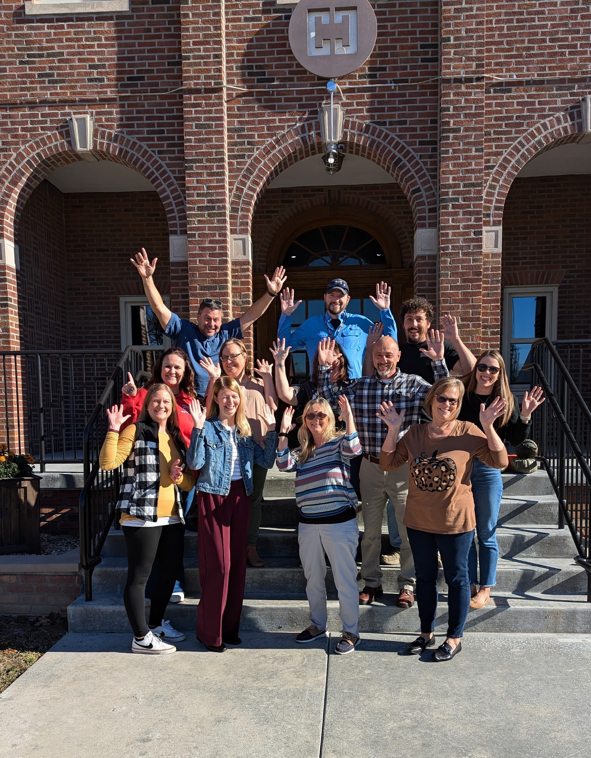
Kaskaskia Region TPC
Kaskaskia Special Education District: Three administrators
Special Education Coordinators/Teachers from three area schools, plus two therapeutic day schools
ROE Superintendent
CTE Director and staff
College Disability Supports Advisor
Supported Employment representative
PUNS agency representatives
CILA representatives
DRS case manager
State agency representatives: ICTW, DSCC
Local bus company representative

Slide 21
Goals and Projects

Slide 22
Initial Agenda
Be brief, but provide enough information to make people feel welcome and interested
Introductions: Committee organizers and individuals from each organization
Where is their organization located?
What does their organization do to support individuals with disabilities?
What gaps do they see in the transition from school to adult living?
Short and long term goals for the committee
Short term: Vision/mission statement
Long term: Resource brochure, resource fair, website, plans for growth
Set follow-up meeting date (monthly for first semester, bi-monthly following year)
Topics to brainstorm before next meeting
Shared Google Doc/Drive

Slide 23
Follow Up Meeting Agendas: Consistent Format
Review of Minutes from previous meeting: Secretary e
Discussion Items: New information to share, including committee reports, concerns and accomplishments
Roundtable: Each domain/representative
Announcements and Upcoming Events: PD opportunities, activities and events in the area
Future Meeting Dates, Topics to Brainstorm, Mission Statement (meeting #2)
1.
2.
3.
4.
5.

Slide 24
Records Kept
Meeting agenda
Meeting minutes/your notes
Presentations/slide decks
Emails: with TPC members, DRS/other agencies, families, vendors for fair or other events
Any outside communication

Slide 25
Timeline: Planning and Getting Started
Spring 2023/Fall 2024
Networking with semi-local TPCs and attending meetings
Brainstorming potential committee members
Researching TPC information/requirements
Winter 2024
January: Initial Meeting
February: Mission statement and goals established
March: Officer Election
Spring 2024
April: Committee discussions
May: Schedule meetings for 24-25 school year

Slide 26
Timeline: This School Year
Fall 2024
Attending conferences, hosting PD
Scheduling new events: Resource Fair, Parent Training, etc
Committee work: Brochure, website, fair
DRS Mini-Grant submitted and funded
Spring 2025: Major Events
Parent Training Nights: Significant support needs and college/workforce bound
Resource Fair: Area transition age students, district staff, families, media, homeschool families
Welcome to the Real World: Area 8th grade students

Slide 27
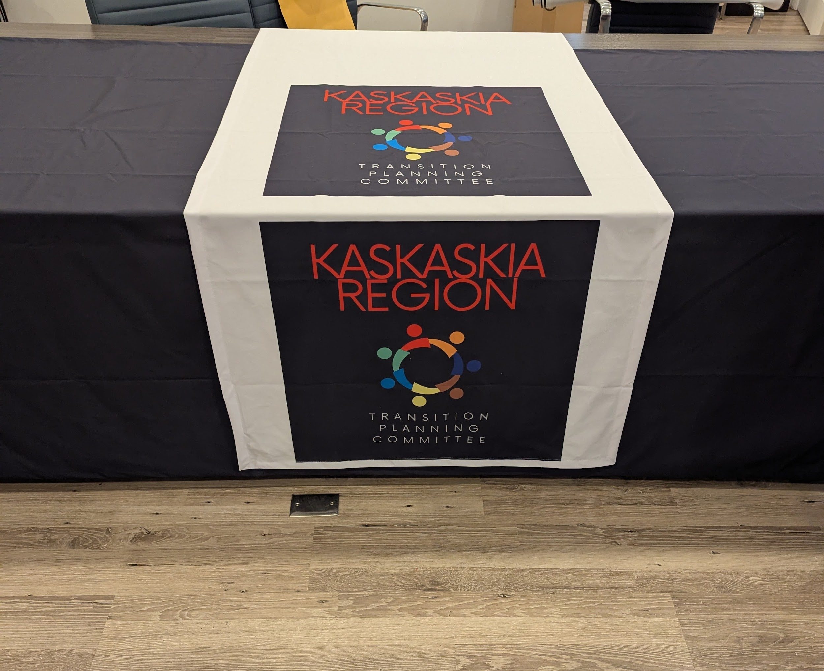
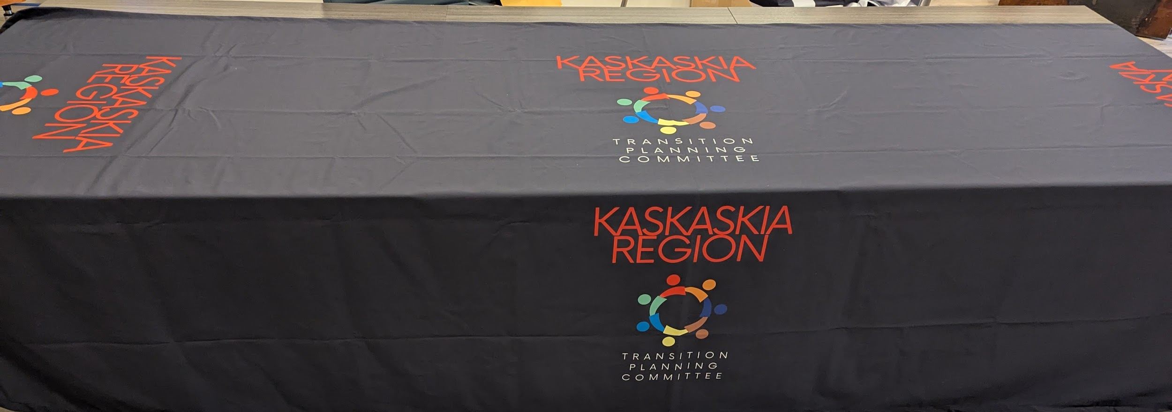
Materials Purchased with DRS TPC Mini-Grant
Pre-Ets Curriculum for Lending Library
TPC Table Runner
TPC Event Banner
TPC Tablecloth
Grant applications released annually in the fall

Slide 28
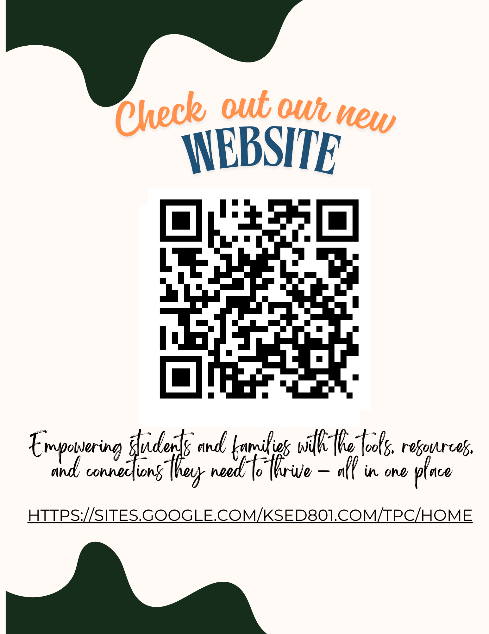
Website
https://sites.google.com/ksed801.com/tpc/home

Slide 29
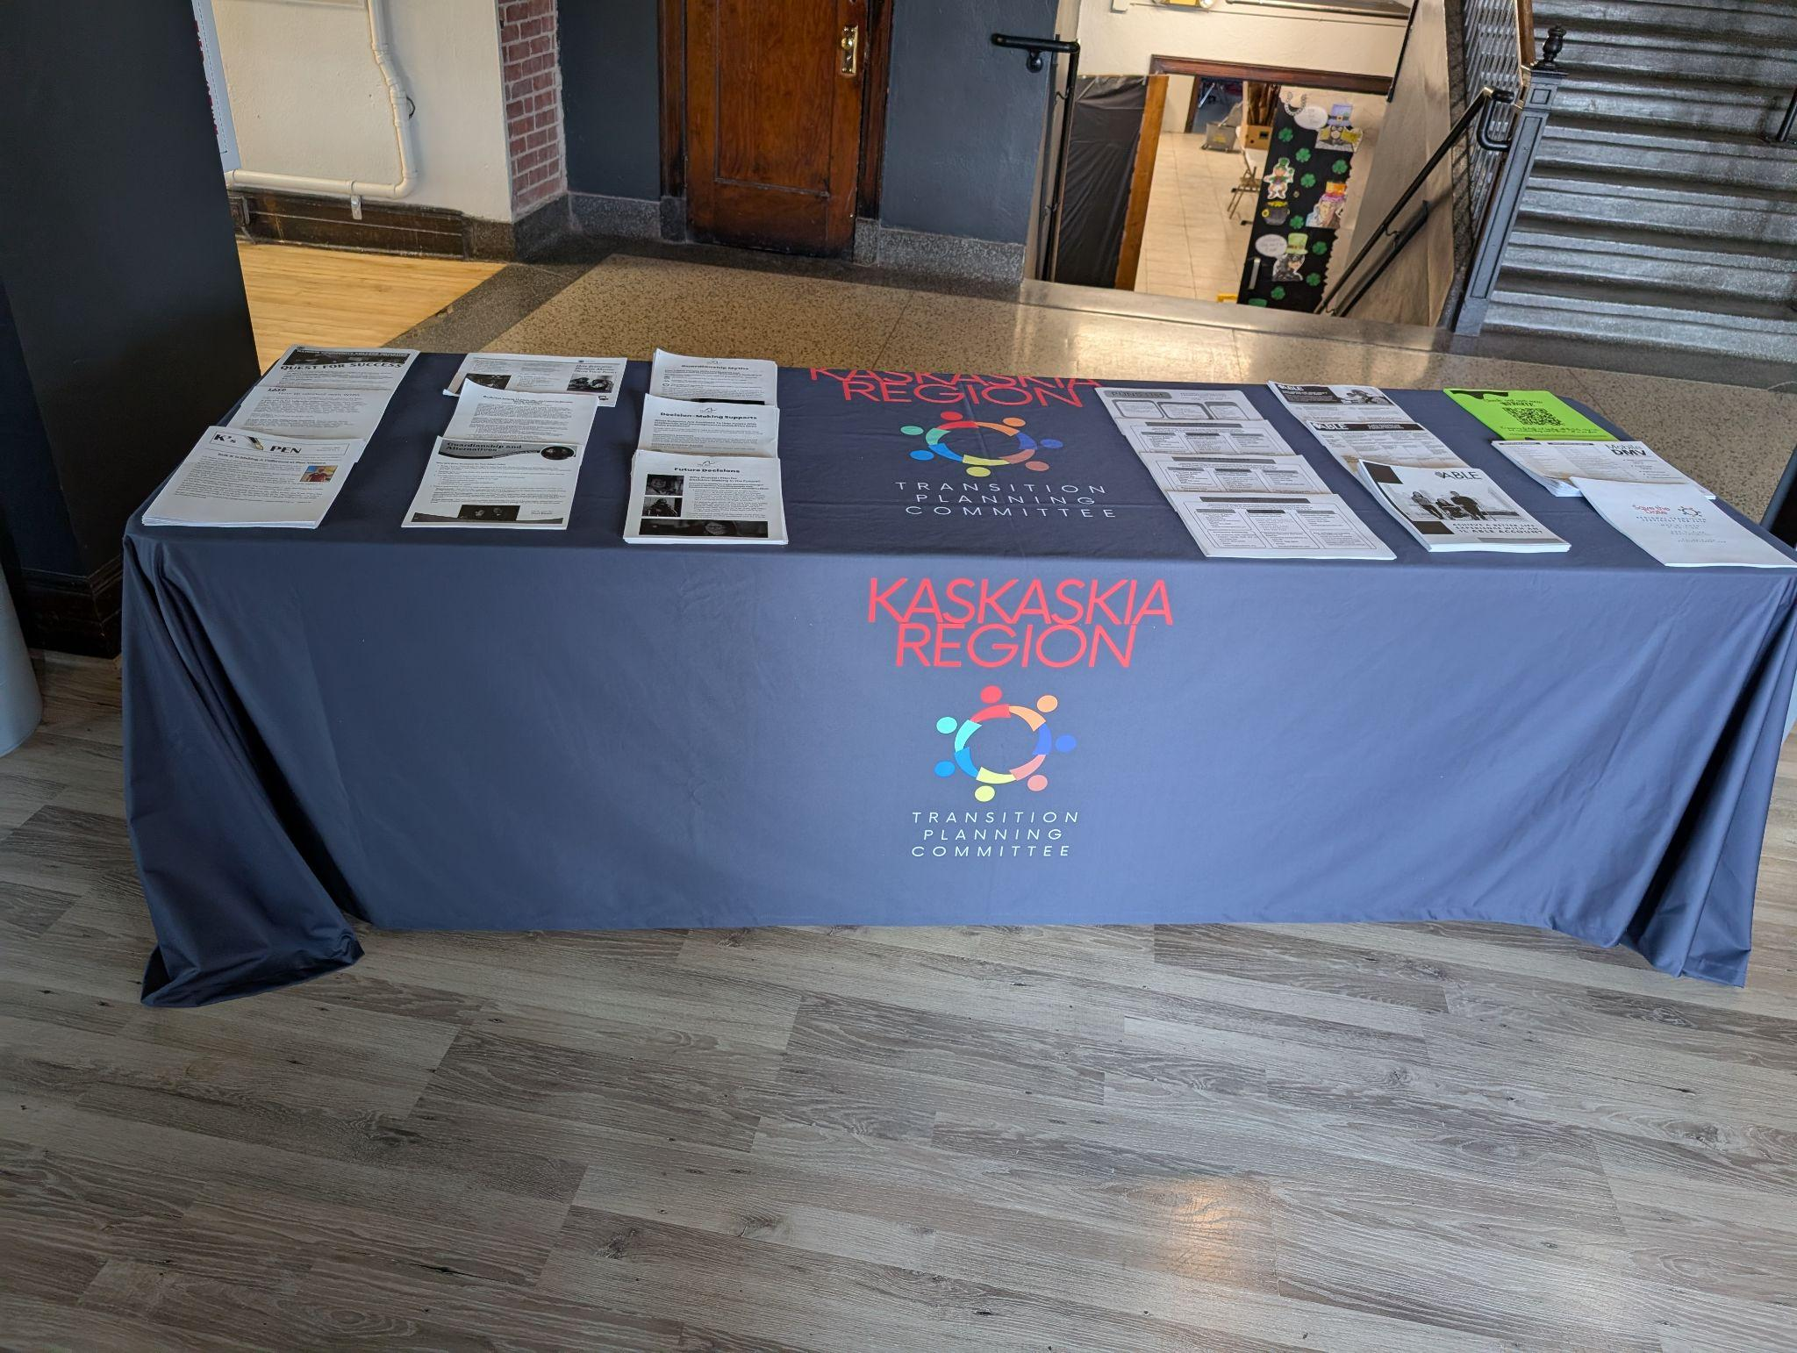
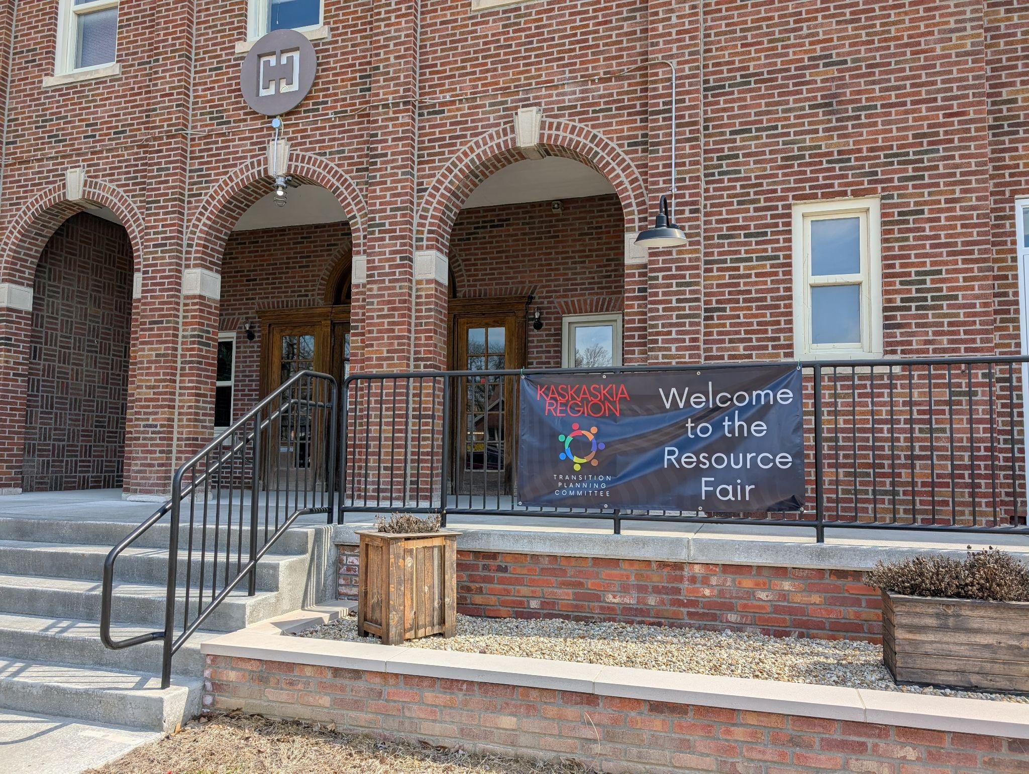
Plans for Growth
Geographic Expansion
Invite school representatives from nearby counties in the co-op to join KRTPC and/or potentially begin a TPC in their county
Committee/Project Expansion
Identify gaps/needs
Add student/parent representatives
Regional/statewide agencies
Create new events to support parents and students as well as districts
Look for funding opportunities for larger scale projects and events
Information sharing/pushing information out to students/districts/families

Slide 30
Considerations
Focus on the “It Takes a Village” concept
Leverage your social capital and that of your colleagues
Locate the statewide experts in transition/TPCs and reach out to them
Find semi-local experts/other TPC’s and open lines of communication
Network with local stakeholders to identify gaps/needs, including parents/students
6. Be bold: Invite a wide range of potential committee members (increases social capital range)
7. Don’t get overwhelmed: Comparing your beginning to another committees “middle” is not helpful
8. Attend regional, state and national conferences focusing on transition annually: network, resources, brainstorming ideas
9. Online invites/reminders/meeting options
10. Value your team/committee while eyeing expansion plans

Slide 31
Q & A:
What is on your mind?
How can we help?

Slide 32
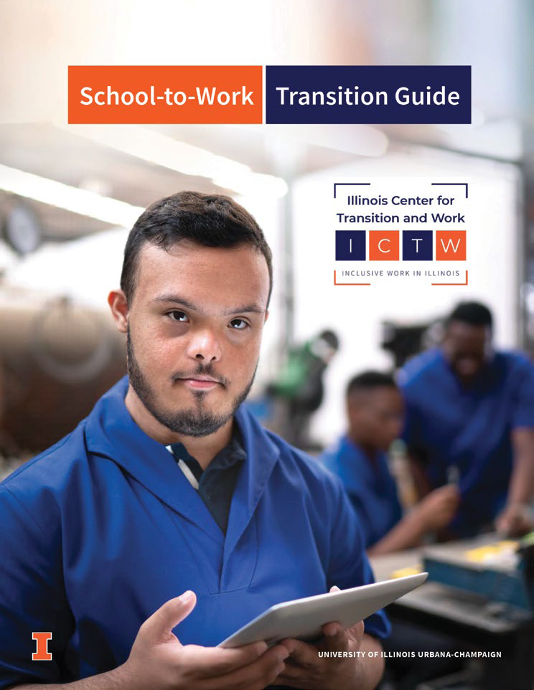
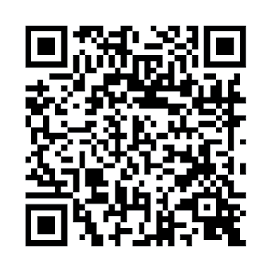
School-to-Work Transition Guide: Page 25
TPC Guidelines
Notes:
Nicole All of these guidelines for operating a TPC can be found in our school to work transition guide found on page 25

Slide 33
Resources
https://sites.google.com/ksed801.com/tpc/home Kaskaskia Region TPC
https://ictw.illinois.edu/ Illinois Center for Transition to Work (ICTW)
https://iris.peabody.vanderbilt.edu/ IRIS Center
https://transitionta.org/ National Technical Assistance Center on Transition
https://www.illinoislifespan.org/website-links/transition-resources/ The ARC of Illinois
https://www.irp.wisc.edu/resource/many-rural-americans-are-still-left-behind/ Institute for Research on Poverty
https://www.illinoisworknet.com/ State of Illinois Workforce Portal

Slide 34
References
Everson, J. M., Ivester, J., & Cordoni, L. (2019). The development of local interagency transition teams: A report from the Transition Alliance of South Carolina (TASC). Journal of Vocational Rehabilitation, 50(3), 243–248. https://doi.org/10.3233/jvr-191003
Gross, T., Thomas, F., & Held, M. (2019). Making a collective impact: A School-to-Work Collaborative
model. Journal of Vocational Rehabilitation, 51 (2019) 395-407
Hoover, A. (2016). The role of the community in the transition to the adult world for students with
disabilities. American Secondary Education, 44(2)
Marzzoti et al. (2020). Secondary transition predictors of postschool success: An update to the research
base. Career Development and Transition for Exceptional Individuals, Vol 44(1) 47-64
Test, D. W., Mazzotti, V. L., Kwiatek, S., & Chang, W. (2020). Effective strategies for interagency collaboration. In Routledge eBooks (pp. 297–312). https://doi.org/10.4324/9780429198342-21

Slide 35
Thank you for attending!
Dr. Nicole Birri: nbirri@illinois.edu
Abby Clark: aclark@ksed801.com

Slide 38
Legal Requirements, cont.
Every Student Succeeds Act (ESSA, 2015)
Requires training for teachers and joint professional development for teachers in collaboration with career and technical educators and educations from institutions of higher learning
Test, D. W., Mazzotti, V. L., Kwiatek, S., & Chang, W. (2020). Effective strategies for interagency collaboration. In Routledge eBooks (pp. 297–312). https://doi.org/10.4324/9780429198342-21
Notes:
Nicole

Slide 39
Legal Requirements, cont.
Workforce Innovation and Opportunity Act (WIOA, 2014)
Requires state and local boards to coordinate and align workforce programs to provide coordinated, complementary and consistent services to job seekers and employers
Requires at least 15% of the funding to state vocational rehabilitation agencies to provide pre-employment transition services to support youth with disabilities in the transition from secondary to postsecondary school and employment
Test, D. W., Mazzotti, V. L., Kwiatek, S., & Chang, W. (2020). Effective strategies for interagency collaboration. In Routledge eBooks (pp. 297–312). https://doi.org/10.4324/9780429198342-21
Notes:
Nicole

