Slide 1


Social Security, Medicare and Medicaid Work Incentives
Earn more, keep your benefits

Slide 2

Learning objectives
Attendees will learn how the government definition of “disability” for students over 18 hinges on the students’ capacity to work.
Attendees will explore how understanding Social Security and Medicaid work incentives can overcome students’ and parents’ hesitance to pursue paid employment.
Attendees will learn the basics of the Social Security Administration’s “Ticket to Work.”
Attendees will learn the basics of the various Work Incentives that apply to:
  Supplemental Security Income (SSI)
  Social Security Disability Insurance (SSDI)
  Medicaid

Slide 3

From both Federal and State mandates, employment is a key transition goal
The individualized education program (IEP), developed under the Individuals with Disabilities Education Act (IDEA), for each student with a disability must address transition services requirements beginning not later than the first IEP to be in effect when the child turns 16, or younger if determined appropriate by the IEP Team, and must be updated annually thereafter. The IEP must include:
appropriate measurable postsecondary goals based upon age-appropriate transition assessments related to training, education, employment, and, where appropriate, independent living skills; and
the transition services (including courses of study) needed to assist the student with a disability in reaching those goals).

Slide 4
Adult eligibility for Disability Benefits hinges on the limited capacity to earn income
To be eligible for Social Security disability benefits, a person over the age of 18 must:
Have a medically determinable physical, mental or emotional disability that is expected to last a year or more or end in death and
The disabling condition(s) must prevent the person from performing Substantial Gainful Activity by earning more than $1,620 per month (2025, non-blind). For Blind individuals, SGA is $2,700/month.
As a result, students with disabilities and/or their parents or guardians may be concerned that earning at all or earning “too much” will make them ineligible for cash disability benefits health care (Medicare, Medicaid) or support services (Medicaid waivers).

Slide 5


This creates a certain tension for transition students and their families
Many students want to secure competitive, integrated employment but
Many will also require supports and services to live an independent adult life.
Earning “too much” income could endanger students’ and graduates’ status of “having a disability” and thereby
Cost them access to those necessary adult services.

Slide 6


People with disabilities, particularly intellectual disabilities, are constitute the most under- or unemployed demographic
Only 34% of individuals with intellectual disability between the ages of 18 and 64 are working
Only 18% are working in competitive employment*
The unemployment and underemployment statistics are even lower for adults of color with a disability

Slide 7
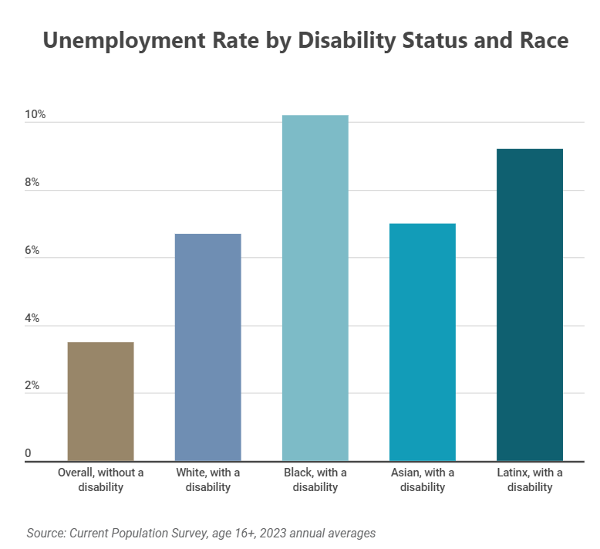
Fear of losing key benefits is one of the reasons why people with disabilities have a higher unemployment rate than others.

Slide 8
Social Security, Medicare and Medicaid Work Incentives can help people with disabilities work more, without losing their benefits but:
Many people with disabilities receive incorrect information about how employment will affect their benefits.
01
Many people with disabilities are unaware of Work Incentives or do not understand the rules that govern their application.
02
Parents and guardians are reluctant to encourage work lest their students lose key benefits.
03
School transition staff are unfamiliar with Work Incentives and are reluctant to give students and families incorrect information.
04

Slide 9
How to add Benefits and Work Incentives Education to the transition process
School educators are experts in academic and vocational education. Their primary role is to help students develop transition plans that build on students’ strengths and interests.
Per the US Department of Education as well as the Illinois State Board of Education, the goal of transition planning is to prepare students with disabilities for further education, independent living and employment.
Many students with disabilities can be successful in competitive, integrated employment, but sill still rely on Social Security cash benefits to achieve maximum financial stability..
Many students with disabilities can be successful in competitive, integrated employment but will still require adult support services funded by Medicaid Waiver to achieve maximum independence.
To properly balance the goal of obtaining employment with the goal of maintaining benefits, transition programs can add benefits counselors to the transition team and process.

Slide 10
Providing Work Incentives Benefits Counseling has proven effective to improve employment outcomes
Research has found that:
Transition aged youth, including those with intellectual disability, who receive Work Incentives Benefits Counseling have higher rates of employment.
Transition aged youth, including those with intellectual disability, who receive Work Incentives Benefits Counseling have higher hourly wages and
Transition aged youth, including those with intellectual disability, who receive Work Incentives Benefits Counseling work more hours per week.
Source: Iwanaga et al., 2021

Slide 11
Students who work in competitive, integrated employment:
Frequently have more overall income that students who receive benefits only.
01
Have opportunity to contribute to their communities.
02
Have the opportunity to continue learning and building new skills.
03
Have a sense of pride in their accomplishments.
04
Have opportunities to interact and build relationships with co-workers.
05
Build social capital that can help them develop other areas of their lives.
06

Slide 12

What is the “Ticket to Work”?
A free suite of services to help people with disabilities start, return to or enhance work. Anyone who receives Supplemental Security Income (SSI) or Social Security Disability Insurance (SSDI) has a Ticket.

Slide 13

What does the Ticket to Work offer?
The Ticket to Work provides services, which are free to Ticket-holders. These include:
career counseling
skills and knowledge assessment
locating education and training opportunities
designing and requesting work accommodations
resume- writing assistance
interview coaching and
job search and placement assistance.
Once a Ticket is started, it runs on a timeline, so we recommend students wait to use their Ticket until after leaving transition.

Slide 14
“Employment Networks” help Ticket holders build Individual Work Plans
Research
research accredited programs
Select
select a program
Arrange
arrange technology and transportation
Determine
determine your class schedule
Pass
pass the classes,
Obtain
obtain an internship,
Create
create a targeted resume,
Locate
locate practices that are hiring,
Interviewing
practice interviewing
Interview
interview, and follow up
State Vocational Rehabilitation Agencies, non-profits and even individuals can act as Employment Networks. Suppose a student with a disability wants to become a Veterinary Assistant. IWP steps might include:

Slide 15

Social Security Work Incentives
Take into account the special circumstances and needs of workers with disabilities.
Are designed to encourage people with disabilities to begin work, increase the level of their work or return to work without risking their safety net.
May apply to Supplemental Security Income (SSI), Social Security Disability Insurance or both.
Also extend beyond Social Security to Medicare and Medicaid.
Medicaid is an exceptionally important benefit because it funds support services for adults.

Slide 16


These Work Incentives are available to people receiving SSI
The Student Earned Income Exclusion allows students under the age of 22 who are regularly attending secondary or postsecondary education to receive their full SSI payment as long as their monthly earnings do not exceed $2,350 and their annual earnings do not exceed $9,460.
The Earned Income Exclusion applies to working adults with disabilities who are over 22 and/or no longer full-time students. The first $20 dollars of any income, the first $65 of earned per month and half of the remaining earned income do not reduce SSI payable.

Slide 17


These Work Incentives are available to people receiving SSI
Section 1619(a) of the Social Security code states that a person whose income exceeds Substantial Gainful Activity (SGA) may still be eligible to receive a reduced cash payment. This is because, per the formula, a person would have to earn $2,019 before SSI payable would be reduced to $0.
Section 1619(b) of the Social Security code states that a person who receives SSI and Medicaid concurrently before the SSI payable is reduced to $0 due to earned income remains categorically eligible for Medicaid.

Slide 18

These Work Incentives are available to people receiving SSI
Medicaid Buy-in (Health Benefits for Workers with Disabilities).
A worker who has SSI but does not have Medicaid and
Begins to work and earns enough income that her/his SSI payable is reduced to $0
Can still obtain Medicaid as a Worker with a Disability by
Paying a sliding scale premium, based on earned and unearned income

Slide 19



What is a Plan to Achieve Self-Support (PASS)?
PASS provides a way for SSI recipients to channel non-SSI income as well as countable resources to fund a self-designed program to enhance their employability. A PASS must have a stated employment goal, concrete steps, a through budget and a timeline. For example, Lucy has a goal of working as a veterinary assistant. Lucy’s PASS includes:
Taking a Vet Assistant Program Course: $1,999.
Books and materials: $300
Purchasing a laptop and peripherals: $850
Sitting the Approved Vet Assistant (AVA) exam: $100
A timeline of 18 months.

Slide 20
How does funding a PASS work?

Slide 21





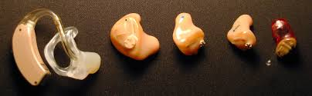
These work incentives apply to people who receive either or both SSI & SSDI
Impairment Related Work Expense (IRWE)
A good or service that meets these 3 criteria may be an IRWE:
Required because of the disabling condition(s)
Required to work
Paid for out-of-pocket
Once approved by the SSA, IRWE will be deducted before earned income is counted.

Slide 22
IRWE examples

Slide 23
These Work Incentives apply to people who receive either SSI or SSDI or both
Expedited Reinstatement allows a person whose SSI or SSDI payments have ceased due to earned income to restart them if:
  Their SSI or SSDI payments ceased due to earned income and
  They are no longer able to perform work that meets the Substantial Gainful Activity definition for
  The same disabling condition(s) for which they were initially approved and
  For SSDI cases, this occurs withing 60 months of the SSDI cessation.

Slide 24
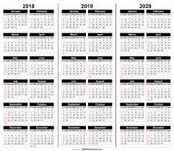
These Work Incentives apply to people who receive SSDI
The Trial Work Period allows a worker to earn income in excess of SGA and still receive their SSDI payment. However, each month in which income exceeds the Trial Work threshold ($1,160 for 2025) constitutes a Trial Work Month. Once 9 Trial Work Months have accumulated, the Trial Period is over.
The worker than has 36 consecutive months in which they are eligible for their SSDI payment for any month in which their earned income does NOT exceed SGA. This is called the Extended Period of Eligibility.

Slide 25

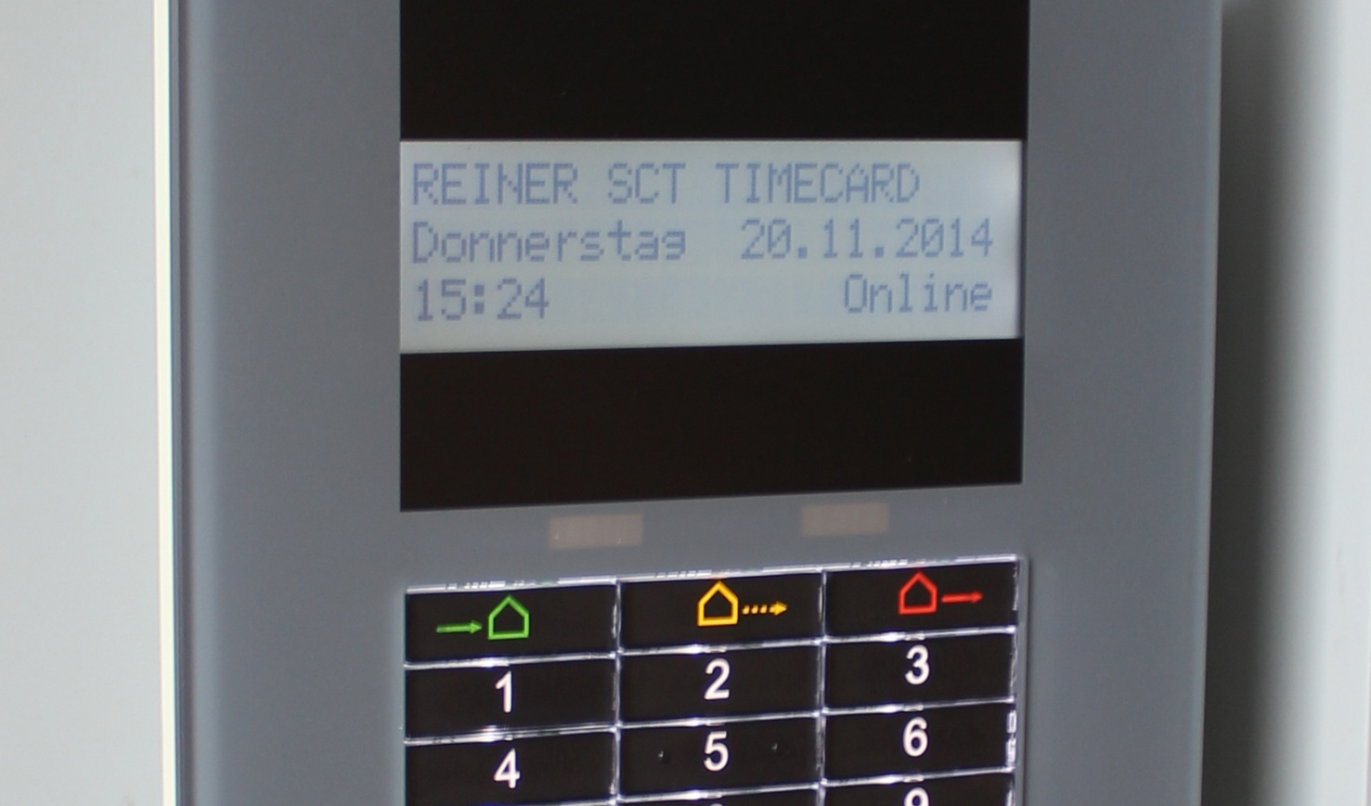

These Work Incentives apply to people who receive SSDI
Subsidies and Special Conditions
Employers may provide workers with disabilities certain accommodation or adaptations. For example:
An employee with a disability may be exempted from working in the stock room because s/he cannot lift heavy objects or
An employee with a disability who tires easily may be allowed to take additional breaks or
An employee with a disability may have more lenient rate or pace requirements for work.

Slide 26

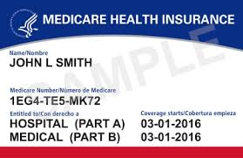
These Work Incentives apply to people who receive SSDI
Unicurred business expenses. If a person on SSDI starts her/his own business, s/he can deduct from revenue business expenses covered by third parties.
Continued Medicare Coverage. Workers who cease to receive SSDI due to earned income have an Extended Period of Medicare Coverage that lasts for 93 months from the end of their Trial Work Period.
Medicare Buy-in. Subsequently, workers can continue their Medicare coverage by paying the premiums as long as their disabling conditions continue.

Slide 27
How will a student’s benefits evolve over their lifetime?
Most students with disabilities in transition will be eligible for SSI and Medicaid at the age of 18.
Once they begin paid employment, they will accumulate Social Security credits.
When they have accumulated sufficient credits (varies by age), they will be eligible for SSDI. Depending on their earned income and SSDI amount, they may continue to be eligible for some SSI.
Once they have been eligible for SSDI for 24 months, they become eligible for Medicare. Many continue to maintain Medicaid eligibility as well.
If they continue to meet the Social Security definition of “having a disability” until their parents’ file for Social Security, they will begin to receive an additional amount (called “Childhood Disability Benefit” or “Disabled Adult Child”) benefit.
If they have not already qualified for Medicare, they will after 24 months of receiving a CDB/DAC benefit.

Slide 28

Example: Mark as transition student
Mark applied and was determined eligible for SSI at the age of 18.
Mark likes to be physically active and is concerned about the environment.
Mark’s transition team helps him find an unpaid internship monitoring and collecting the recycling containers for the high school, as well as the middle and lower schools nearby.
Since Mark is not earning any income, his work has no impact on his SSI payments.
Mark is building employment skills.

Slide 29

Mark as a final year transition student
In his last year of transition, Mark’s transition team helps him find a paid internship at the Village Hall, emptying the recycling bins and doing other light maintenance.
Mark is a W-2 employee and earns about $600 per month.
Once Mark turns 22, although still regularly attending school, he is no longer eligible for the Student Earned Income Exclusion, so his SSI payment is reduced.
His SSI is reduced by about 50 cents for every dollar he earns after the general exclusion of the first $85/month.
As Mark pays FICA taxes, he will earn Social Security credits.
When he has sufficient credits, he will become eligible for SSDI.

Slide 30

Example: Dana, as a current transition student
Dana applied and was determined eligible for SSI when she turned 18.
Dana loves interacting with people and being around and talking about animals.
That same year, Dana’s job developer helped her find a paid internship at the local zoo as a guide.
Dana begins to work 15 hours per week, while still regularly attending her transition program.
Dana earns $970/month. Because Dana is a student under the age of 22, she retains her full SSI payment due to the Student Earned Income Exclusion.
Once she turns 22, her SSI will be reduced by about 50 cents for every dollar she earns.

Slide 31

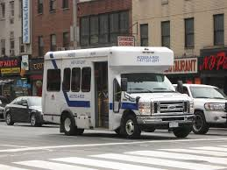

Example: Dana as a graduate
Dana continues her paid internship at the zoo throughout her transition program. Her hours gradually increase.
Because Dana receives W-2 income and pays FICA taxes, she accumulates Social Security quarters of credit (aka “credits”).
When Dana completes transition at the age of 22, she has already accumulated enough credits to make her eligible for SSDI.
Dana works 25 hours per week at $15/hour. Since she has some Impairment Related Work Expenses (IRWE), her countable earned income is < $1,620 (SGA) and she maintains her SSDI eligibility.

Slide 32

Example: Casey, as a current transition students
Casey applies for Social Security disability benefits when they turn 18.
Because Casey’s father already receives Social Security retirement benefits, Casey is immediately eligible for a Childhood Disability Benefit (Title II).
Casey’s transition team finds them a part-time paid position at a local diner, where they earn approximately $750 per month.
Because Casey’s earned income is below the Trial Work threshold, they do not accumulate any Trial Work Months.
Because Casey’s earned income is well below the Substantial Gainful Activity threshold, Casey continues to receive their full CDB benefit.

Slide 33

Example: Casey as a graduate
Casey continues to work at the diner after graduation. Their hours increase and they get a pay raise until they are earning approximately between $1,000 and $1,250 per month.
For every month that Casey earns more than $1,160, they accumulate a Trial Work Month.
When they have accumulated 9 Trial Work Months in a rolling 60-month period, they will have completed their Trial Work phase.
Subsequently, they will retain their CDB eligibility for 36 months, but will only receive cash in the months that their earned income is below the SGA threshold.
From month 37, if Casey’s earned income stays below the SGA threshold, they will retain their eligibility for their CDB benefit. If the earned income exceeds that threshold, they will not.
Informed Choice

Slide 34
How can ABLE accounts help?
Both SSI and Medicaid are means-tested benefits, so eligibility requires limited financial assets.
While a PASS can exclude financial assets from consideration, a PASS can fund only employment goals and is useful only while those goals are in progress.
ABLE can exclude financial assets from SSI and Medicaid eligibility consideration throughout the person’s lifetime.
The person with a disability is both the owner and beneficiary of her/his ABLE account, although they can give access permission to another.
A person may contribute themselves or have others contribute on their behalf up to $19,000 per year to an ABLE account.

Slide 35

How can ABLE accounts help?
Under current law, workers with a disability who do not contribute to any employer-sponsored retirement plan may contribute and additional amount to an ABLE equal to the lesser of the Federal Poverty Level or their entire earned income. This provision is set to expire at the end of 2025
A person can have up to $100,000 in an ABLE account and still receive SSI. If the account exceeds $100,000, SSI payments are suspended until the account value decreases.
ABLE account assets are never considered for Medicaid eligibility purposes.
Funds in an ABLE account can be invested, and investment returns grow on a tax deferred basis, similar to a Roth account.

Slide 36





How can ABLE accounts help?
Funds can be withdrawn for a wide range of “Qualified Disability Expenses,” and the withdrawal will not be taxed. QDEs may include:
  Education and training
  Technology
  Medical expenses
  Travel
  A vehicle or other transportation costs
  Housing costs
If the owner/beneficiary dies, any money remaining in the ABLE may be subject to Medicaid recovery.

Slide 37
To summarize:
Employment is a key transition goal for students with disabilities.
A limitation on one’s capacity for employment is a key element in the government definition of disability for people over the age of 18.
Transition students and their families may be concerned that employment success will undermine eligibility for benefits.
Social Security and Medicaid Work Incentives are designed to help people with disabilities work more while maintaining benefit eligibility.
The rules for applying Work Incentives are complicated.
Transition curriculum should include education on Work Incentives for students and their families.

Slide 38

Questions?

Slide 39

For more information contact:
Alexandra Baig, MBA, CFP®, ChSNC®, NSSA®, CWIP®
Pathways to Benefits, LLC
alexandra@pathwaystobenefits.com
https://www.pathwaystobenefits.com

Slide 40
Academic Resources
Brooke, V., & McDonough, J. T. (n.d.). The Facts Ma’am, Just the Facts.
Gelber, A., Moore, T. J., & Strand, A. (2017). The Effect of Disability Insurance Payments on Beneficiaries’ Earnings. American Economic Journal: Economic Policy, 9(3), 229–261. https://doi.org/10.1257/pol.20160014
Goda, G. S., Shoven, J. B., & Slavov, S. N. (2019). Work incentives in the Social Security Disability benefit formula. Journal of Pension Economics and Finance, 18(2), 165–189. https://doi.org/10.1017/S1474747218000136
Hanophy, J. (2012). Testimony of the Council of State Administrators of Vocational Rehabilitation (CSAVR) on work incentives in social security disability programs. Journal of Vocational Rehabilitation, 36(1), 13–20. https://doi.org/10.3233/JVR-2012-0578
Hanson, A., Dillahunt-Aspillaga, C. J., & Smith, T. J. (2019). Ticket utilization and implementation: Investigating use patterns of the Ticket to Work program from the consumer’s perspective. Journal of Vocational Rehabilitation, 51(1), 99–110. https://doi.org/10.3233/JVR-191029
Iwanaga, K., Wehman, P., Brooke, V., Avellone, L., & Taylor, J. (2021). Evaluating the Effect of Work Incentives Benefits Counseling on Employment Outcomes of Transition-Age and Young Adult Supplemental Security Income Recipients with Intellectual Disabilities: A Case Control Study. Journal of Occupational Rehabilitation, 31(3), 581–591. https://doi.org/10.1007/s10926-020-09950-7

Slide 41
Academic Resources
Kaya, C., Bishop, M., & Torres, A. (2023). The Impact of Work Incentives Benefits Counseling on Employment Outcomes: A National Vocational Rehabilitation Study. Journal of Occupational Rehabilitation, 33(3), 538–549. https://doi.org/10.1007/s10926-022-10092-1
Kost, A. R. (2025). How Financial Incentives Induce Disability Insurance Recipients to Return to Work.
Kregel, J., & O’Mara, S. (2011). Work Incentive Counseling as a workplace support. Journal of Vocational Rehabilitation, 35(2), 73–83. https://doi.org/10.3233/JVR-2011-0555
Nazarov, Z. E. (2016). Can Benefits and Work Incentives Counseling be a Path to Future Economic Self-Sufficiency for Individuals with Disabilities? Journal of Labor Research, 37(2), 211–234. https://doi.org/10.1007/s12122-016-9223-6
Persons with a Disability: Labor Force Characteristics—2024. (n.d.).
Russell, D. (2012). Testimony on work incentives in Social Security Disability Programs. Journal of Vocational Rehabilitation, 36(1), 33–37. https://doi.org/10.3233/JVR-2012-0580
Weathers, R. R., & Hemmeter, J. (2011). The impact of changing financial work incentives on the earnings of Social Security Disability Insurance (SSDI) beneficiaries. Journal of Policy Analysis and Management, 30(4), 708–728. https://doi.org/10.1002/pam.20611

